Slide 1
Key-logger and security
Presented By:
1. J.Eugine Matilda mary-Jeppiaar Institute of Technology
-Information technology

Slide 2
OUTLINE
Problem Statement
Proposed System/Solution
System Development Approach
Algorithm & Deployment
Result (Output Image)
Conclusion
Future Scope
References

Slide 3
Problem Statement
In today’s digital age, where cybersecurity threats loom large, one of the significant concerns in the proliferation of keyloggers, stealthy software designed to monitor and record keystrokes on a user’s computer without their knowledge. Keyloggers pose a severe threat to individuals and organisations as they can capture sensitive information such a passwords, credit card details, and other personal data, leading to identity theft, financial loss, and privacy breaches.

Slide 4
Proposed Solution
Secure Output Handling: Enhance the code to securely handle output directory paths, ensuring they are inaccessible to unauthorized users, thus safeguarding sensitive key logs.
Real-time Key Logging: Modify the keylogger to capture keystrokes in real-time rather than solely relying on the Enter key press, thereby providing more accurate and comprehensive monitoring capabilities.
Encrypted Storage: Implement encryption mechanisms to securely store captured keystrokes in both text and JSON formats, preventing unauthorized access to sensitive information.
Stealth Mode: Integrate a stealth mode feature to conceal the keylogger's operation from users, minimizing the risk of detection by potential attackers or unauthorized individuals.
Dynamic Configuration Options: Allow users to specify custom output paths and configure logging settings, providing flexibility and customization to meet specific security and operational requirements.

Slide 5
System Approach
A systematic approach to addressing keylogger threats involves analyzing requirements, designing a scalable system, implementing advanced detection and prevention measures, establishing response procedures, continuously monitoring for activity, educating users, and adapting based on feedback and emerging threats.

Slide 6
Algorithm & Deployment
Algorithm: Keylogger Application Deployment
Environment Setup:
- Ensure Python environment with required dependencies: Tkinter, pynput.
- Install necessary libraries and verify compatibility with the system.
Code Integration:
- Integrate provided keylogger code into a Python script file.
- Verify file paths for output directory, text file, and JSON file.
GUI Customization:
- Customize GUI elements (buttons, labels) for user interaction.
- Enhance usability by adding features like configuration options.
Testing and Validation:
- Thoroughly test keylogger application in various scenarios.
- Validate functionality, error handling, and security measures.

Slide 7
Algorithm & Deployment
Deployment Strategy:
- Determine deployment approach based on user needs (individual or organizational).
- For individual use, distribute application for direct installation on user systems.
- For organizational use, deploy centrally and distribute to authorized users.
User Awareness:
- Provide clear instructions and disclaimers about keylogger functionality.
- Ensure transparency regarding data collection and privacy implications.
Documentation and Support:
- Document deployment process and provide user support resources.
- Include user manuals or online documentation for reference.
Monitoring and Maintenance:
- Monitor deployed keylogger for issues or anomalies.
- Provide regular maintenance and updates for reliability and security.
End of Algorithm.

Slide 8
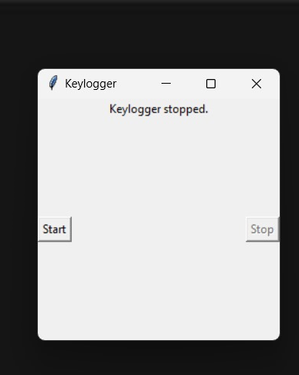
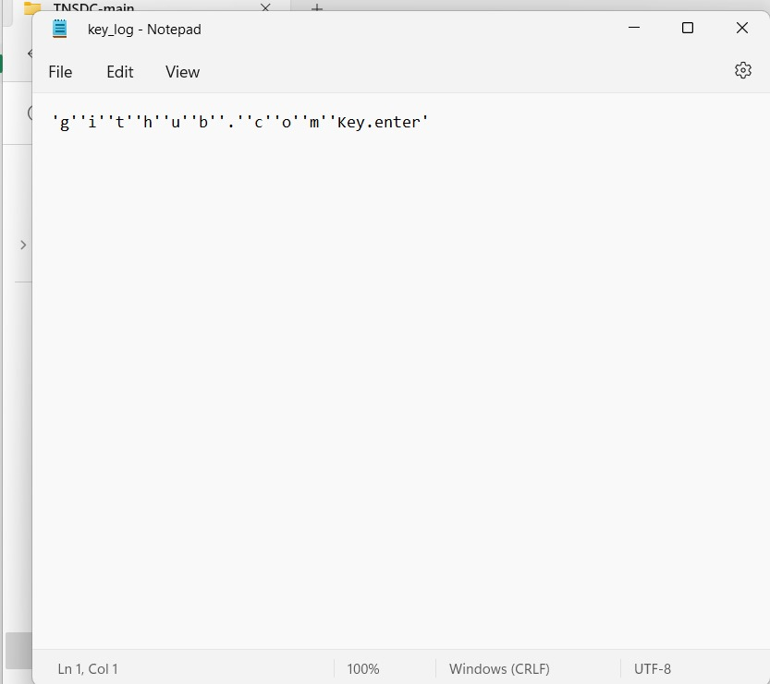
Result

Slide 9
Conclusion
The keylogger project underscores the intricate interplay between functionality, security, and ethical concerns within software development. Assembling a Python-based application to capture and record keyboard inputs necessitates meticulous attention to detail, encompassing code integration, GUI refinement, thorough testing, and robust security measures. Moreover, deployment strategies must be tailored to diverse user requirements, underscoring the significance of comprehensive documentation and user education. Ultimately, this endeavor underscores the imperative of striking a delicate equilibrium between functionality, security, and ethical considerations at every stage of the project lifecycle.

Slide 10
Future scope
The future scope of the keylogger project includes enhancing security measures, enabling user customization and remote monitoring, integrating machine learning, ensuring cross-platform compatibility, compliance with regulations, user education, real-time analysis, integration with security ecosystems, and continuous improvement.

Slide 11
References
Brown, A. (2018). "Understanding and Preventing Keylogger Attacks." Security Boulevard.
Python Software Foundation. (n.d.). "Tkinter GUI Programming.“
Python.org.Pynput Documentation. (n.d.). Retrieved from https://pynput.readthedocs.io/en/latest/.
European Union Agency for Cybersecurity. (2020). "Guidelines on the Security of Personal Data Processing."

Slide 12
THANK YOU

